Slide 1


Programming Language Concepts Tutorials
Become a Programming Languages Designer
Supervised by Dr. Kenny Zhu
TAs: Essam Abdelghany

Slide 2
Pop Quiz
Reminder in tutorials we recap on lecture, discuss assignments, discuss project or programming and solve practice problems.

Slide 3

Pop Quiz
1) If a value of type Bot existed………..
It would mean that such value never breaks code (type-wise) when substituted for another value
Then such value would always result in an error
Type for such value would be a supertype for all other types
Such value would be null

Slide 4
Pop Quiz
2) The type Bot allows ………..
If-else branches to return different concrete types if one of them only performs a side effect such as printing
Functions to return null
A representation for empty structures (e.g., strings)
It has no values; hence, useless

Slide 5
Pop Quiz
3) In logic programming……….
Computation and deduction are unified
If no rule can be applied to reach the facts or premises, then the given claim (query) is certainly false
For loops and if-conditions are explicitly present
Computations possible are as powerful as any other language
Rules are chosen based on matching with the query and performing assignments.
Program:
add(z, N, N).
add(s(N), M, s(P)) :- add(N, M, P).
Query:
?-add(R, s(z), s(s(z)))
Logic:
add(R, s(z), s(s(z)))
Let P=s(z) and M=s(Z) and R=S(N)
>> (i.e., match with add(s(N), M, s(P))
add(N, M, P).
Since P=M=N
add(z, N, N).
Proof done where R=S(S(P)=S(S(S(z)

Slide 6
Pop Quiz
4) In logic programming……….
Disjunction can never be expressed
Disjunction cannot be expressed in a single rule
Code always describes computation
Internal algorithms are used to make decisions on which rule to apply
Backtracking will occur if a rule choice fails

Slide 7
Pop Quiz
Example Fibonacci Program:
fibonacci(0, 0).
fibonacci(1, 1).
fibonacci(N, Result) :- N > 1, fibonacci(N - 1, F1), fibonacci(N - 2, F2), Result is F1 + F2.

Slide 8
Pop Quiz
5) Prolog code is analogous to……….
Database for the file where querying is analogous to SQL
HTML code in that it’s declarative
C++ code in that it explicitly computes
None of the above

Slide 9
Pop Quiz
6) To fix the code below so that it stops backtracking for even number……….
Impossible; Prolog finds all solutions
Use a cut (!) after 0 is X mod 2.
Use a cut (!) before 0 is X mod 2.
None of the above
even_or_odd( X , even ) :- 0 is X mod 2.
even_or_odd( _ , odd ).
?- even_or_odd( 6 , R ).
The cut succeeds when it is called and commits the system to all choices made between the time the parent goal was invoked and the cut.
This includes committing to the clause containing the cut.

Slide 10
Quiz Solution

Slide 11
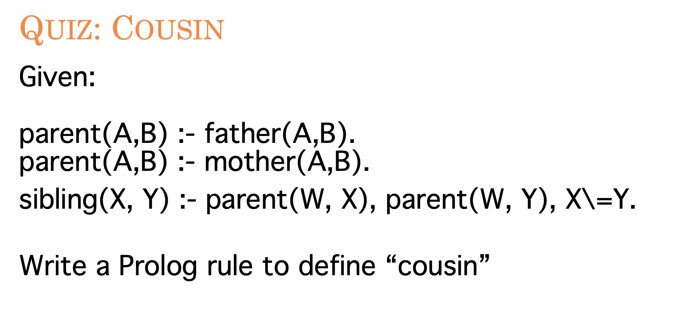
Quiz Solution
Thought process:
cousin(X, Y) X is the cousin of Y
X should have a parent, and Y should have a parent
These parents should be siblings
Thus, cousin(X,Y) :- parent(X1, X), parent(Y1, Y), sibling(X1,Y1)

Slide 12
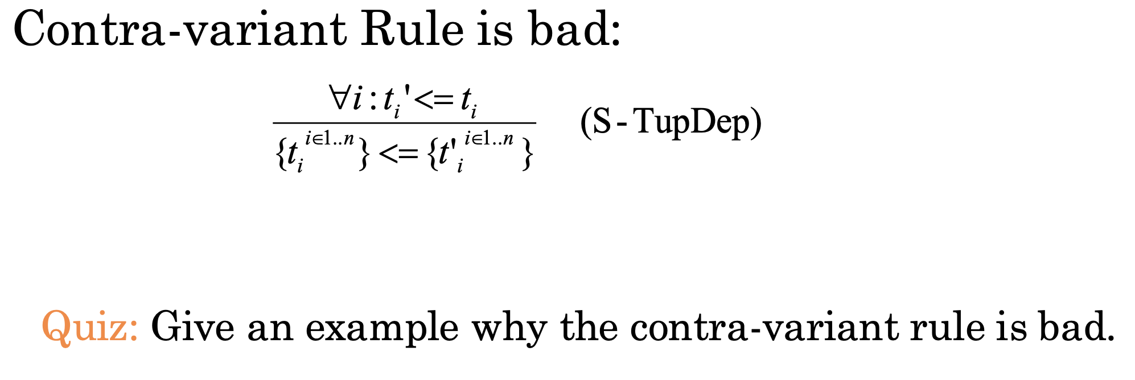
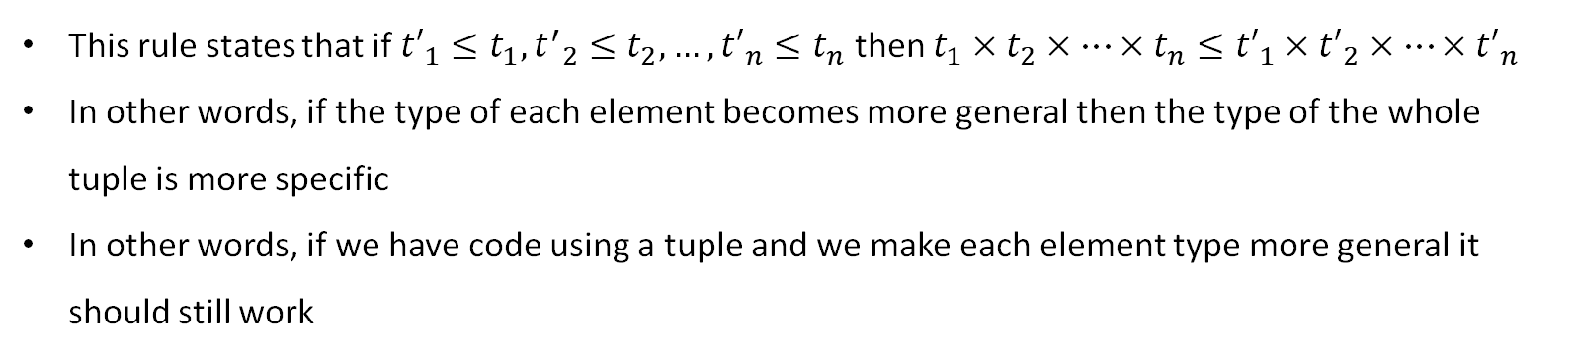
Quiz Solution
This rule states that if ${t′}_{1}≤t_{1},{t^{′}}_{2}≤t_{2},…,{t′}_{n}≤t_{n}$ then $t_{1}×{ t}_{2} ×…×t_{n}≤{t′}_{1}×{ t′}_{2} ×…×{t′}_{n}$
In other words, if the type of each element becomes more general then the type of the whole tuple is more specific
In other words, if we have code using a tuple and we make each element type more general it should still work

Slide 13
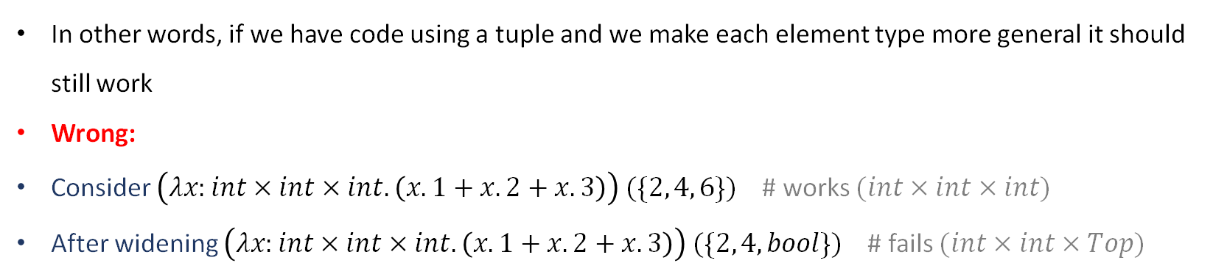
Quiz Solution
In other words, if we have code using a tuple and we make each element type more general it should still work
Wrong:
Consider $\left(λx:int×int×int.\left(x.1+x.2+x.3\right)\right) (\{2, 4, 6\})$ # works $(int×int×int)$
After widening $\left(λx:int×int×int.\left(x.1+x.2+x.3\right)\right) (\{2, 4, bool\})$ # fails $(int×int×Top)$

Slide 14
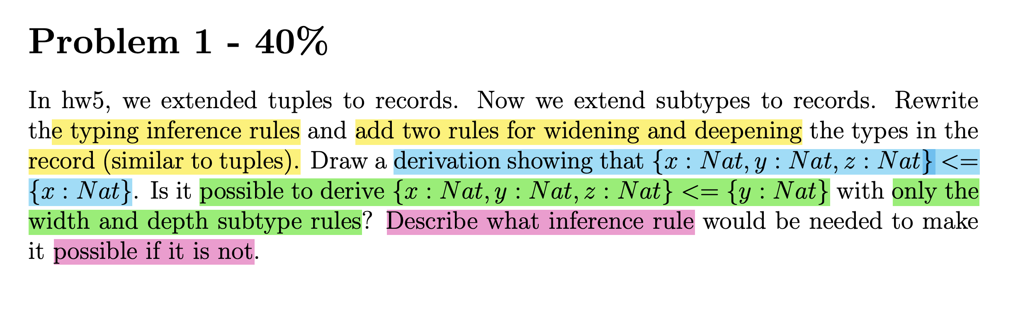
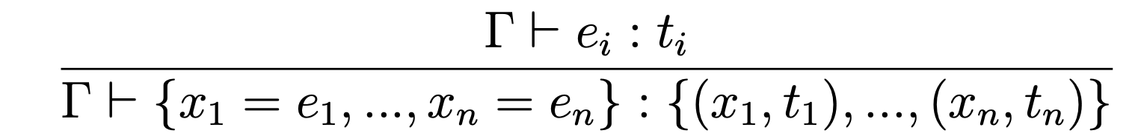
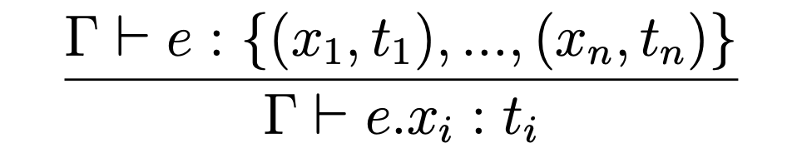
Assignment Solution
As in a previous tutorial:
Rule for typing the entire record expression given its subexpression
Rule for typing record projection given its subexpression types

Slide 15
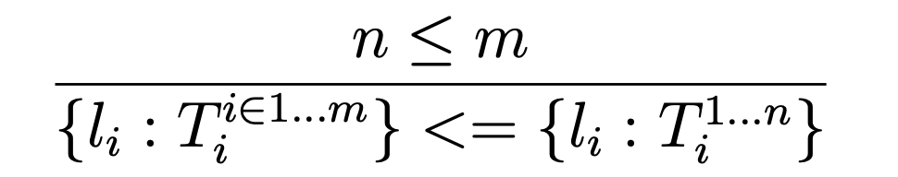
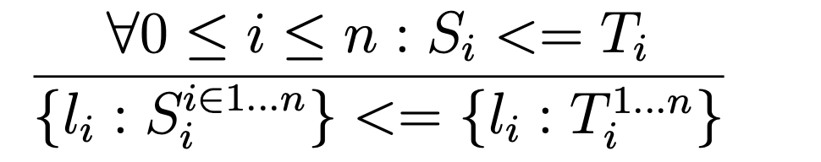
Assignment Solution
As in a previous tutorial:
Rule for typing the entire record expression given its subexpression
Rule for typing record projection given its subexpression types
By directly following tuple type widening or deepening as in the slides:
Wider record is subtype of narrow one. It will always
work in code assuming/using the narrow one.
Deeper record is super type of shallow one. The shallow record will always work in code using/assuming the deeper one.

Slide 16
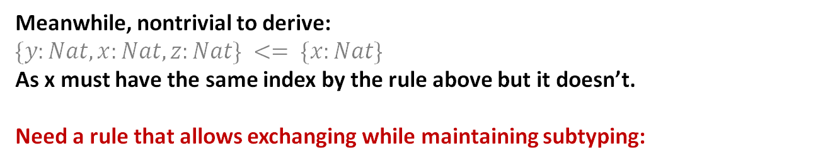
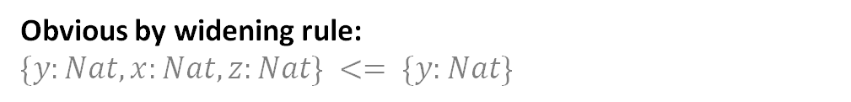
Assignment Solution
By directly following tuple type widening or deepening as in the slides:
Wider record is subtype of narrow one. It will always
work in code assuming/using the narrow one.
Deeper record is super type of shallow one. The shallow record will always work in code using/assuming the deeper one.
Obvious by widening rule:
$$\{y:Nat,x:Nat,z:Nat\} <= \{y:Nat\}$$
Meanwhile, nontrivial to derive:
$$\{y:Nat,x:Nat,z:Nat\} <= \{x:Nat\}$$
As x must have the same index by the rule above but it doesn’t.
Need a rule that allows exchanging while maintaining subtyping:

Slide 17
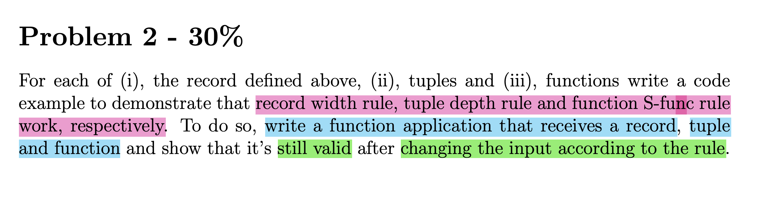
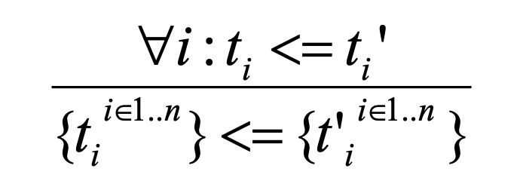
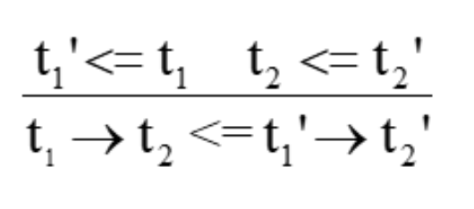
Assignment Solution
Record Width Rule
Tuple Depth Rule
S-Func Rule

Slide 18
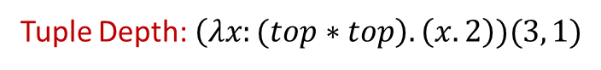
Assignment Solution
Record Width Rule
Tuple Depth Rule
S-Func Rule
Record Width: $\left(λx:\left\{a:int, b:bool\right\}\right).\left(x.a+1\right) (\{a:4, b:true, c:3\})$
Tuple Depth: $\left(λx:(top∗top\right).\left(x.2\right))(3, 1)$
S-Function: $\left(λx:(int→Top\right).\left(x 5\right))\left(λc:\left(Top→int\right).c+1\right)$

Slide 19
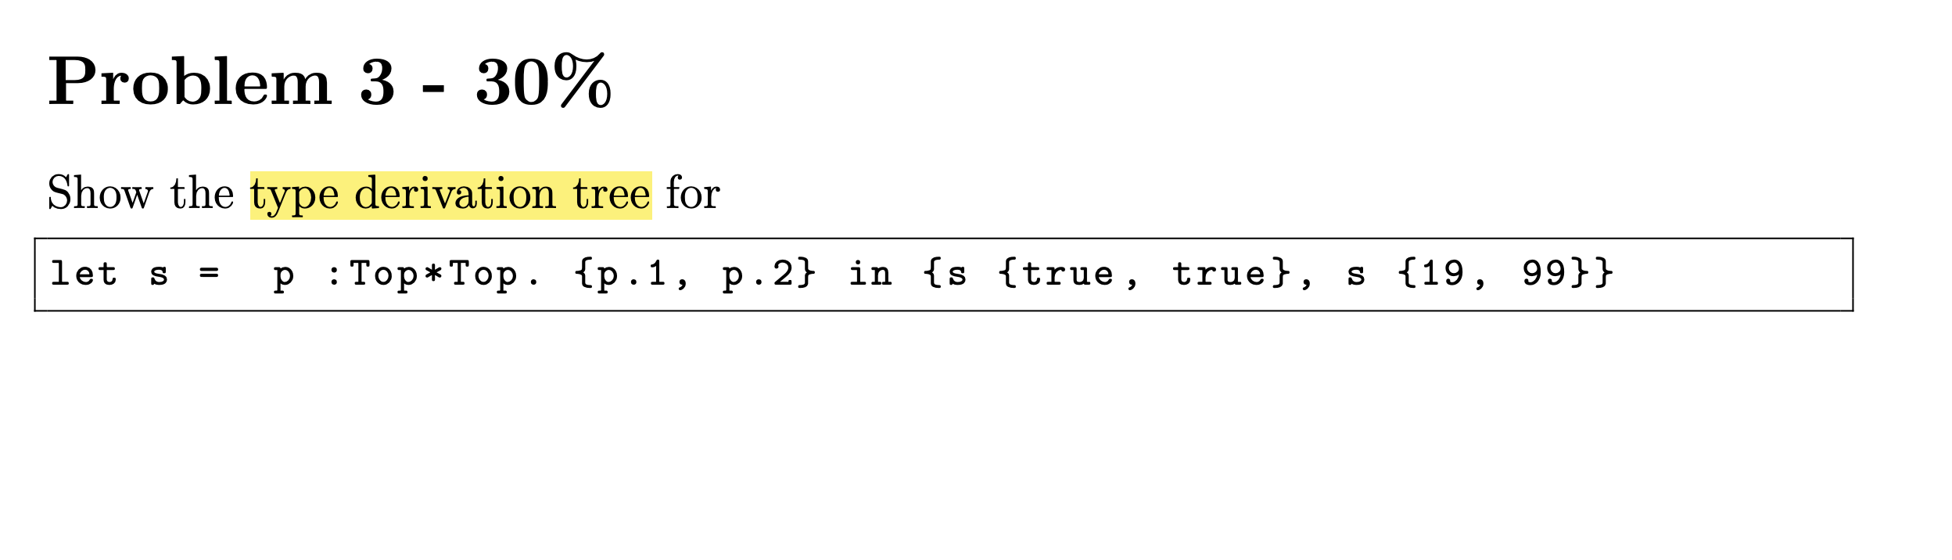
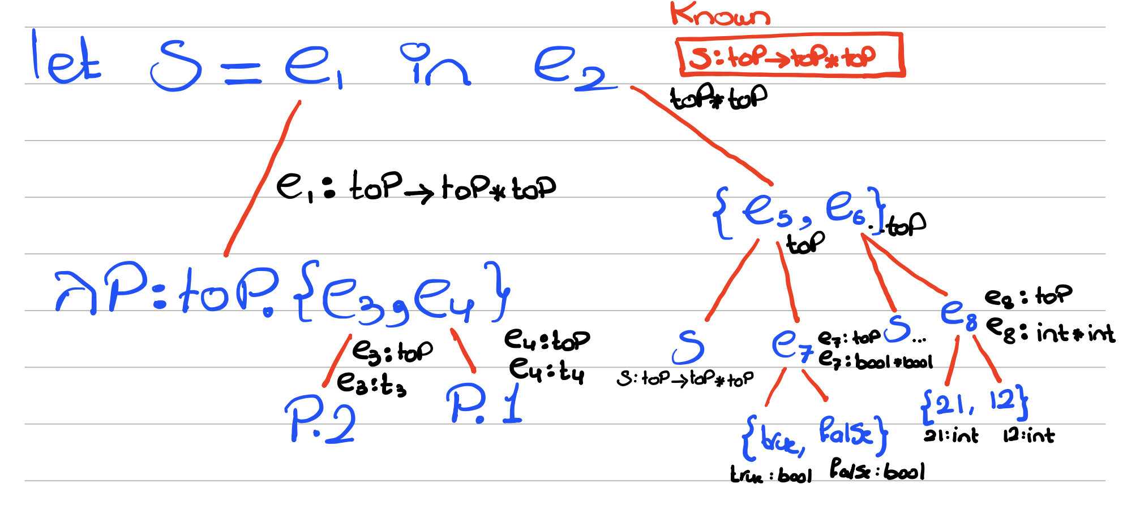
Assignment Solution
All those in yellow become
top*top.
Thus, overall:
(top*top)*(top*top)

Slide 20
Thank You

